Slide 1


Slide 2




Who’s this guy?
https://xdevlogs.com/
Harikrishnan
cn_harikrishnan
cnharikrishnan
cnharikrishnan
cnharikrishnann

Slide 3
Agenda
What is Xamarin? & Why Xamarin?
What is XAML?
XAML Features
MVVM
Data Binding
Styling

Slide 4

Write Once, Run Anywhere

Slide 5
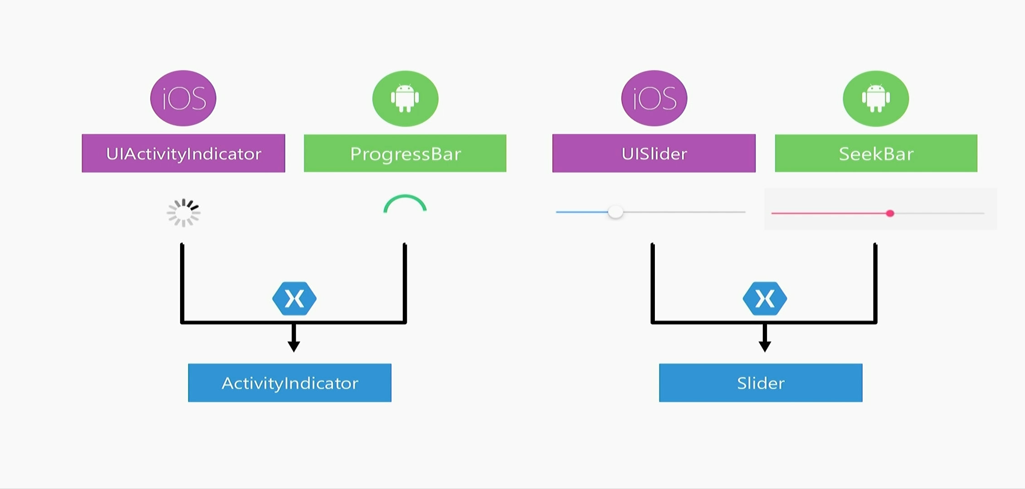
Xamarin Forms Rendering Model

Slide 6
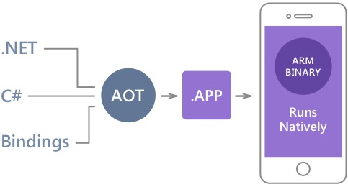
Native Performance
Xamarin.iOS does full Ahead Of Time (AOT) compilation to produce an ARM binary for Apple’s App Store.
Xamarin.Android takes advantage of Just In Time (JIT) compilation on the Android device.

Slide 7
What is XAML?
eXtensible Application Markup Language
Declaratively define UI
Similar to XML but more than that.

Slide 8
XAML Features
Great for MVVM
Visual representation of UI
Toolable
Hot Reload
XAML Previewer

Slide 9
MVVM
Model View ViewModel
Model = Data
View = User Interface
ViewModel = Business logic

Slide 10
Data Binding
Link properties of two objects
so that changes in one property automatically reflects in the other
Integral part of the Model-View-ViewModel (MVVM)
Each view can have only one BindingContext
All data bindings on that view must all reference properties of the same object

Slide 11
Binding Modes
Default
OneWay — values are transferred from the source to the target
OneWayToSource — values are transferred from the target to the source
TwoWay — values are transferred both ways between source and target
OneTime — data goes from source to target, but only when the BindingContext changes

Slide 12
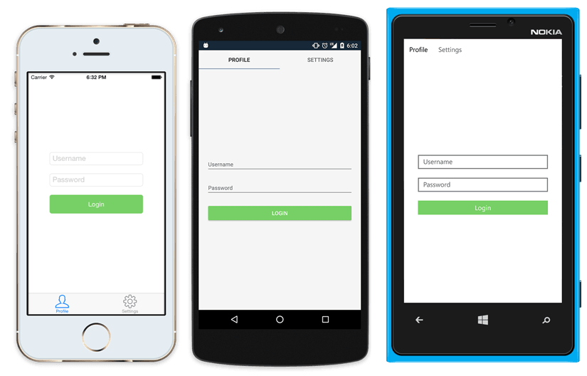
Native UI from shared code
<?xml version="1.0" encoding="UTF-8"?>
<TabbedPage xmlns="http://xamarin.com/schemas/2014/forms"
xmlns:x="http://schemas.microsoft.com/winfx/2009/xaml"
xmlns:local="clr-namespace:XamarinDemo"
x:Class="XamarinDemo.MainPage">
<TabbedPage.Children>
<ContentPage Title="Profile" Icon="Profile.png">
<StackLayout Spacing="20" Padding="20“ VerticalOptions="Center">
<Entry Placeholder="Username“ Text="{Binding Username}"/>
<Entry Placeholder="Password“ Text="{Binding Password}"
IsPassword="true"/>
<Button Text="Login" Command="{Binding LoginCommand}"/>
<Label Text="Login Success" IsVisible="{Binding IsValidLogin}" TextColor="Red" HorizontalTextAlignment="Center" HorizontalOptions="CenterAndExpand"/>
</StackLayout>
</ContentPage>
<ContentPage Title="Settings" Icon="Settings.png">
<Label Text="Settings Page" VerticalOptions="Center" HorizontalOptions="Center" VerticalTextAlignment="Center" HorizontalTextAlignment="Center" />
</ContentPage>
</TabbedPage.Children>
</TabbedPage>

Slide 13
View-to-View Bindings
Define data bindings to link properties of two views on the same page
Do whatever is convenient
<?xml version="1.0" encoding="UTF-8"?>
<ContentPage xmlns="http://xamarin.com/schemas/2014/forms"
xmlns:x="http://schemas.microsoft.com/winfx/2009/xaml"
"clr-namespace:XamarinDemo"
x:Class="XamarinDemo.MainPage“
Title="Slider Bindings Page">
<StackLayout>
<Label Text="ROTATION"
BindingContext="{x:Reference Name=slider}"
Rotation="{Binding Path=Value}“
FontAttributes="Bold" FontSize="Large" HorizontalOptions="Center"
VerticalOptions="CenterAndExpand" />
<Slider x:Name="slider"
Maximum="360"
VerticalOptions="CenterAndExpand" />
<Label BindingContext="{x:Reference slider}"
Text="{Binding Value, StringFormat='The angle is {0:F0} degrees’}”
FontAttributes="Bold" FontSize="Large"
HorizontalOptions="Center"
VerticalOptions="CenterAndExpand" />
</StackLayout>
</ContentPage>

Slide 14
Styling
Explicit Styles
Implicit Styles
Global Styles
Style Inheritance
Dynamic Styles
Device Styles
Style Classes

Slide 15
And much more…
Style using Cascading Style Sheets (CSS)
Theme a Xamarin.Forms Application
Xamarin.Forms Material Visual
Xamarin.Forms Visual State Manager

Slide 16

References
https://dotnet.microsoft.com/learn/xamarin
https://docs.microsoft.com/en-us/xamarin/xamarin-forms/
GitHub source code link
https://github.com/cnharikrishnan/XamarinFormsUI-XAML

Slide 17

https://xdevlogs.com/
Any Queries?
Harikrishnan
cn_harikrishnan
cnharikrishnan
cnharikrishnan
cnharikrishnann

